Slide 1
Solving Inequalities with Variables on Both Sides
3-5
Warm Up
Lesson Presentation
Lesson Quiz
Holt Algebra 1

Slide 3
Objective
Solve inequalities that contain variable terms on both sides.

Slide 4
Use the properties of inequality to “collect” all the variable terms on one side and all the constant terms on the other side.
The Variables are the VIP’s take care of them 1st then move to the remaining terms.
Make the larger variable pull the smaller variable to its side.

Slide 5
Check It Out! Example 1b
Solve the inequality and graph the solutions.
5t + 1 < –2t – 6
5t + 1 < –2t – 6
To collect the variable terms on one side, add 2t to both sides.
+2t +2t
7t + 1 < –6
Since 1 is added to 7t, subtract 1 from both sides to undo the addition.
– 1 < –1
7t < –7
Since t is multiplied by 7, divide both sides by 7 to undo the multiplication.
7t < –7
7 7
t < –1
–4
–3
–2
–1
0
1
2
3
4
5
–5

Slide 6
Example 1A: Solving Inequalities with Variables on Both Sides
Solve the inequality and graph the solutions.

Slide 8
You may need to simplify one or both sides of an inequality before solving it. Look for like terms to combine and places to use the Distributive Property.

Slide 9
Example 3A: Simplify Each Side Before Solving
Solve the inequality and graph the solutions.
2(k – 3) > 6 + 3k – 3
2(k – 3) > 3 + 3k
Distribute 2 on the left side of the inequality.
2k + 2(–3) > 3 + 3k
2k – 6 > 3 + 3k
To collect the variable terms, subtract 2k from both sides.
–2k – 2k
–6 > 3 + k
–3 –3
Since 3 is added to k, subtract 3 from both sides to undo the addition.
–9 > k

Slide 10
Example 1B: Solving Inequalities with Variables on Both Sides
Solve the inequality and graph the solutions.

Slide 11
Example 3B: Simplify Each Side Before Solving
Solve the inequality and graph the solution.
0.9y ≥ 0.4y – 0.5

Slide 12
Check It Out! Example 3a
Solve the inequality and graph the solutions.

Slide 13
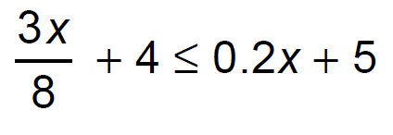

Slide 14
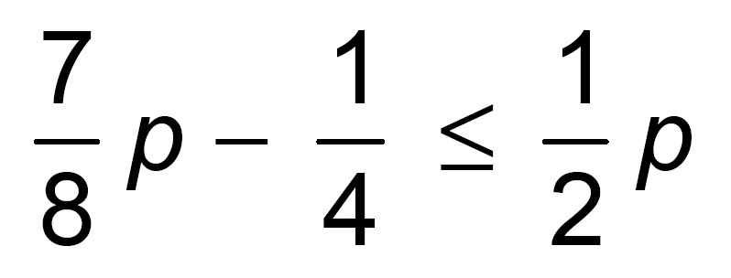

Slide 17
HW p. 200 #37-44, 50-54 even

