Slide 1
Multiplication Properties
of Exponents
7-3
Warm Up
Lesson Presentation
Lesson Quiz
Holt McDougal Algebra 1
Holt Algebra 1

Slide 2
Warm Up
Write each expression using an exponent.
1. 2 • 2 • 2
2. x • x • x • x
3.
Write each expression without using an exponent.
4. 4³
5. y²
6. m^{–4}
2³
4 • 4 • 4
y • y

Slide 3
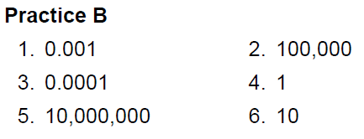
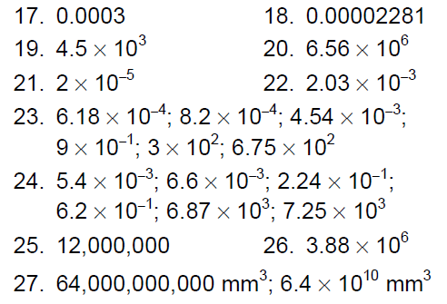
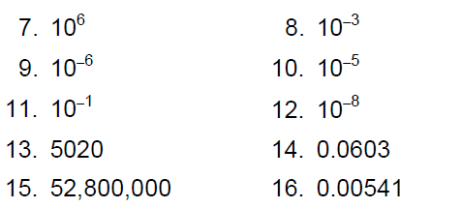

Slide 4
Objective
Use multiplication properties of exponents to evaluate and simplify expressions.

Slide 6
Products of powers with the same base can be found by writing each power as a repeated multiplication.
Notice the relationship between the exponents in the factors and the exponents in the product
5 + 2 = 7.

Slide 7
When multiplying number with the same base add their exponents.
Remember every # has an exponent.

Slide 8
Example 1: Finding Products of Powers
Simplify.
A.
Since the powers have the same base, keep the base and add the exponents.
B.
Group powers with the same base together.
Add the exponents of powers with the same base.

Slide 9
Example 1: Finding Products of Powers
Simplify.
C.
Group powers with the same base together.
Add the exponents of powers with the same base.
D.
Group the positive exponents and add since they have the same base
Add the like bases.
1

Slide 10
Check It Out! Example 1
Simplify.

Slide 11
Check It Out! Example 1 Continued
Simplify.
5.

Slide 12
Example 2: Astronomy Application
Light from the Sun travels at about miles per second. It takes about 15,000 seconds for the light to reach Neptune. Find the approximate distance from the Sun to Neptune. Write your answer in scientific notation.
distance = rate × time
Write 15,000 in scientific notation.
Use the Commutative and Associative Properties to group.
Multiply within each group.
mi

Slide 13
Check It Out! Example 2
Light travels at about miles per second. Find the approximate distance that light travels in one hour. Write your answer in scientific notation.
distance = rate × time
Write 3,600 in scientific notation.
Use the Commutative and Associative Properties to group.
Multiply within each group.

Slide 14
To find a power of a power, you can use the meaning of exponents.
Notice the relationship between the exponents in the original power and the exponent in the final power:

Slide 15
When taking a power to a power multiply the exponents.

Slide 16
Example 3: Finding Powers of Powers
Simplify.
Use the Power of a Power Property.
Simplify.
Use the Power of a Power Property.
Zero multiplied by any number is zero
1
Any number raised to the zero power is 1.

Slide 17
Example 3: Finding Powers of Powers Continued
Simplify.
C.
Use the Power of a Power Property.
Simplify the exponent of the first term.
Since the powers have the same base, add the exponents.
Write with a positive exponent.

Slide 18
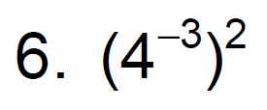
Check It Out! Example 3
Simplify.

Slide 19
Check It Out! Example 3c Continued
Simplify.

Slide 20
Powers of products can be found by using the meaning of an exponent.

Slide 21
Example 4: Finding Powers of Products
Simplify.
A.
Use the Power of a Product Property.
Simplify.
B.
Use the Power of a Product Property.
Simplify.

Slide 22
Example 4: Finding Powers of Products
Simplify.
C.
Use the Power of a Product Property.
Use the Power of a Power Property.
Simplify.

Slide 23
Check It Out! Example 4
Simplify.

Slide 24
Check It Out! Example 4 Continued
Simplify.
c.

Slide 25
Lesson Quiz: Part I
Simplify.
1. 3²• 3⁴
3.
5.
7.
2.
(x³)²
4.
6.
8. (2.9 × 10³)(2.3 × 10²)

